Slide 1
V LOGESHWARAN
Final Project
Presented By:
LOGESHWARAN V
Alpha College of Engineering
BE CSE Department
3/21/2024 Annual Review
1

Slide 2
Steganography in Augmented reality

Slide 3

AGENDA
Problem Statement
Proposed System/Solution
System Development Approach
Algorithm & Deployment
Result
Conclusion
Future Scope
References

Slide 4

Problem Statement
The growing popularity of Augmented Reality (AR) applications creates a need for secure methods to embed and transmit hidden data within the AR content. This data could be text, images, audio, or other digital information. Traditional communication channels might be vulnerable or inappropriate for certain use cases. Develop a robust and user-friendly system for steganography in AR that effectively

Slide 5
Proposed Solution
Data Processing Module (Python):
Handles data conversion (text, image, audio) to a bitstream suitable for embedding.
Implements steganographic techniques to embed the data into the AR content while minimizing perceivable changes.
Communicates with the AR application logic using appropriate libraries (e.g., Python for Unity).
AR Content Modification Module (AR Development Platform):
Integrates with the chosen AR development platform (Unity, ARKit, ARCore etc.).
Receives data from the Data Processing Module.
Applies steganographic techniques to modify the AR content (images, videos, 3D models) based on the received data bits.
User Interface (AR Application):
Provides user-friendly interfaces for:
Selecting AR content for data embedding.
Specifying data to be hidden (text input, file selection etc.).
Security and Error Correction:
Implement a shared secret key between sender and receiver for enhanced data security during encoding and decoding..
Integrate error correction mechanisms within the Data Processing Module to handle potential data loss or corruption during extraction.

Slide 6
WHO ARE THE END USERS?
Artists and Designers: Artists and designers may use steganography in AR to embed hidden messages, images, or additional content within their AR artworks, enhancing the viewer's experience and providing hidden layers of meaning.
Educators: Educators can employ steganography in AR to create interactive learning experiences where hidden clues, information, or challenges are embedded within AR scenes, engaging students and promoting active learning.
Gamers: Game developers may integrate steganography into AR games to add hidden Easter eggs, rewards, or storyline elements within the game environment, encouraging exploration and discovery among players.
Tourism and Travel: In tourism and travel applications, steganography in AR can be used to provide tourists with hidden historical facts, anecdotes, or navigation hints within AR-enhanced guided tours or city exploration apps.
Marketing and Advertising: Marketers and advertisers might leverage steganography in AR campaigns to deliver hidden promotional messages, discounts, or exclusive offers to consumers who interact with AR content, creating a sense of mystery and intrigue.

Slide 7

System Approach
The AR steganography has minimal system requirements and can run on most modern computers. Here's a breakdown:
Software:
Python 3 (or compatible version) - The code is written in Python and requires a Python interpreter to be installed. Python is freely available for most operating systems.
Open cv2 library (usually included) - The code utilizes the cv2 library for image, which is typically included in the standard Python installation with images
Hardware:
No specific hardware requirements - This code doesn't perform computationally intensive tasks and can run on any computer capable of running Python.

Slide 8
Algorithm & Deployment
Data Preprocessing :
Convert data to suitable digital format (text -> ASCII, image -> bitplanes).
Apply compression (optional) for improved capacity.
Convert preprocessed data into a bitstream.
AR Content Selection & Analysis :
Imperceptibility (low-contrast areas in images, inaudible frequencies in audio).
Embedding Capacity (data bits embeddable without affecting quality).
Data Embedding :
LSB manipulation: Modify least significant bits to match data bits.
Transform domain methods: Apply mathematical transformations, embed data, and perform inverse transformation.
AR Content Rendering :
Render modified AR content on AR display or software application.
Ensure high visual/auditory quality and imperceptible embedded data.

Slide 9
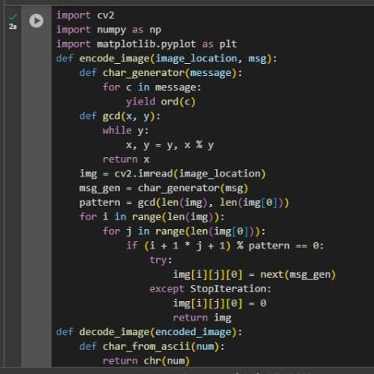
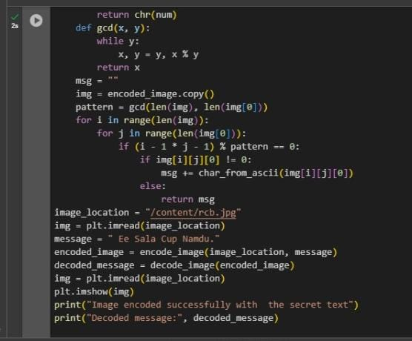
MODELLING

Slide 10
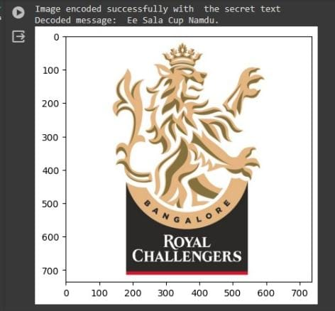
Result
The code embeds the message within an image using LSB steganography. It converts the text to binary, modifies the cover image's least significant bits to hide the data, and saves a new image. The resulting image appears unchanged but holds the secret message

Slide 11

Conclusion
Steganography in AR offers a powerful tool for embedding hidden data within augmented reality experiences. This approach balances imperceptibility with data capacity, enabling secure communication and innovative AR applications. By leveraging advanced steganographic techniques, enhanced security features, and standardized protocols, the future of this technology is bright. From interactive learning experiences to secure AR communication, steganography in AR has the potential to revolutionize how we interact with and utilize augmented reality.

Slide 12
Future scope
Advanced AR Steganographic Techniques:
Deep Learning-based Methods: Explore deep learning algorithms to analyze AR content and identify optimal embedding locations that maximize capacity while maintaining imperceptibility. These algorithms could dynamically adapt to different content types and user preferences.
Content-Adaptive Techniques: Develop steganographic techniques that automatically adjust based on the specific AR content. For example, the system might use LSB modification for images and transform domain methods for 3D models, optimizing data hiding for each content type.
Emerging AR Applications:
Augmented Reality Learning: Embed interactive quizzes or additional information within AR objects for a more engaging and personalized learning experience. Students could scan AR markers or objects to reveal hidden data, enhancing their understanding of the subject matter.
Interactive AR Experiences: Hide clues, objectives, or rewards within AR environments for location-based games or immersive storytelling experiences. Users could progress through the experience by interacting with hidden data embedded within the AR content.

Slide 13
References
Hohne, K., & Fuhrmann, A. (2012). A survey of augmented reality technologies, applications and limitations. International Journal of Virtual Reality, 11(2), 11-20
Mishra, S. K., Rawat, R. S., & Tyagi, S. (2020). Steganography in Augmented Reality: A Survey. In 2020 International Conference on Innovative Computing and Communications (ICICC) (pp. 1-6). IEEE.
Chaudhary, A., Rani, P., & Singh, K. (2020). Steganography in Augmented Reality Using Object Detection. In Proceedings of the 2020 International Conference on Communication, Computing and Internet of Things (IC3IoT) (pp. 1-4).
Le, T., & Yoshida, T. (2018). An Efficient Steganography Technique for 3D Object in Augmented Reality. In 2018 10th International Conference on Knowledge and Systems Engineering (KSE) (pp. 214-218). IEEE.
Ismail, A., Shalan, A., & Nazar, E. S. (2019). Steganography in Augmented Reality Based on Gabor Filter. In 2019 International Conference on Communications, Signal Processing, and their Applications (ICCSPA) (pp. 1-4). IEEE.
Raj, P., & Praveen, J. (2020). Steganography in Augmented Reality using Color Image Based Approach. In 2020 Fourth International Conference on I-SMAC (IoT in Social, Mobile, Analytics and Cloud) (I-SMAC) (pp. 241-246). IEEE.

Slide 14
THANK YOU

